Slide 1
Digital Portfolio
STUDENT NAME: S. SHIVA SUNDAR
REGISTER NO AND NMID: 42DB673368B6DE794E948498C4D5B6CA
DEPARTMENT: BCA
COLLEGE: HINDUSTAN COLLEGE OF ARTS AND SCIENCE

Slide 2
PROJECT TITLE
Student Digital Portfolio using Frontend Development

Slide 3


AGENDA
Problem Statement
Project Overview
End Users
Tools and Technologies
Portfolio design and Layout
Features and Functionality
Results and Screenshots
Conclusion
Github Link
3/21/2024 Annual Review

Slide 4

PROBLEM STATEMENT
In today’s digital era, a traditional resume is not sufficient to highlight skills and achievements. Many students and professionals lack a structured online presence. A digital portfolio provides an interactive and accessible platform to showcase skills, projects, and accomplishments effectively

Slide 5

PROJECT OVERVIEW
This project is a personal digital portfolio developed using front-end technologies.
It includes sections such as About Me, Projects, Skills, and Contact.
The main objective is to create a professional online space to showcase achievements, technical expertise, and academic work.

Slide 6

WHO ARE THE END USERS?
Students: To present academic projects and resumes.
Job Seekers: To share with recruiters for better visibility.
Freelancers: To showcase work and attract potential clients.
Professionals: To highlight career achievements and experience

Slide 7
TOOLS AND TECHNIQUES
HTML: Provides the structure for web pages and sections.
CSS: Adds styling, layout, colors, and responsiveness.
JavaScript: Enables interactivity, navigation, animations, and form validation.

Slide 8
POTFOLIO DESIGN AND LAYOUT
Home/About Me: A brief introduction with personal details.
Projects: Display of academic and personal projects with descriptions.
Skills: A section showcasing technical and soft skills.
Contact: Form to reach out directly with email or messages.
Responsive Layout: Optimized for both desktop and mobile devices.
‹#›

Slide 9
FEATURES AND FUNCTIONALITY
User-friendly navigation bar with smooth scrolling.
Interactive project showcase with images and descriptions.
Hover effects and animations for a dynamic user experience.
Contact form with validation for user interaction.
Fully responsive design that adapts to all screen sizes.

Slide 10
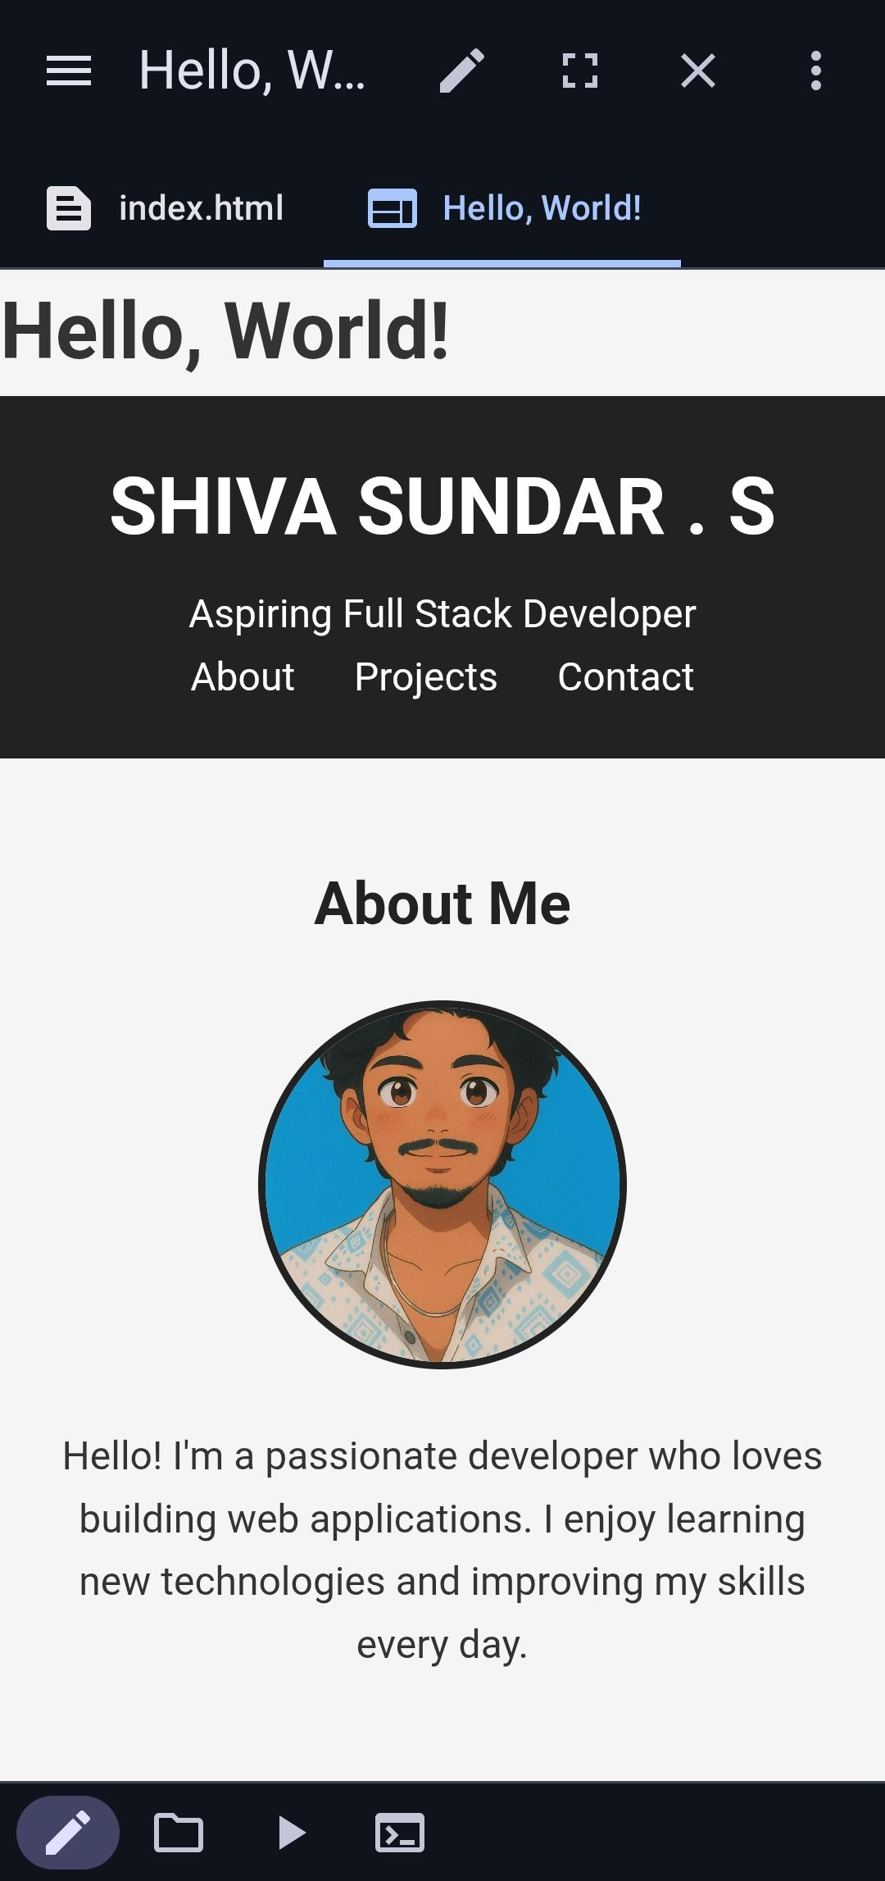
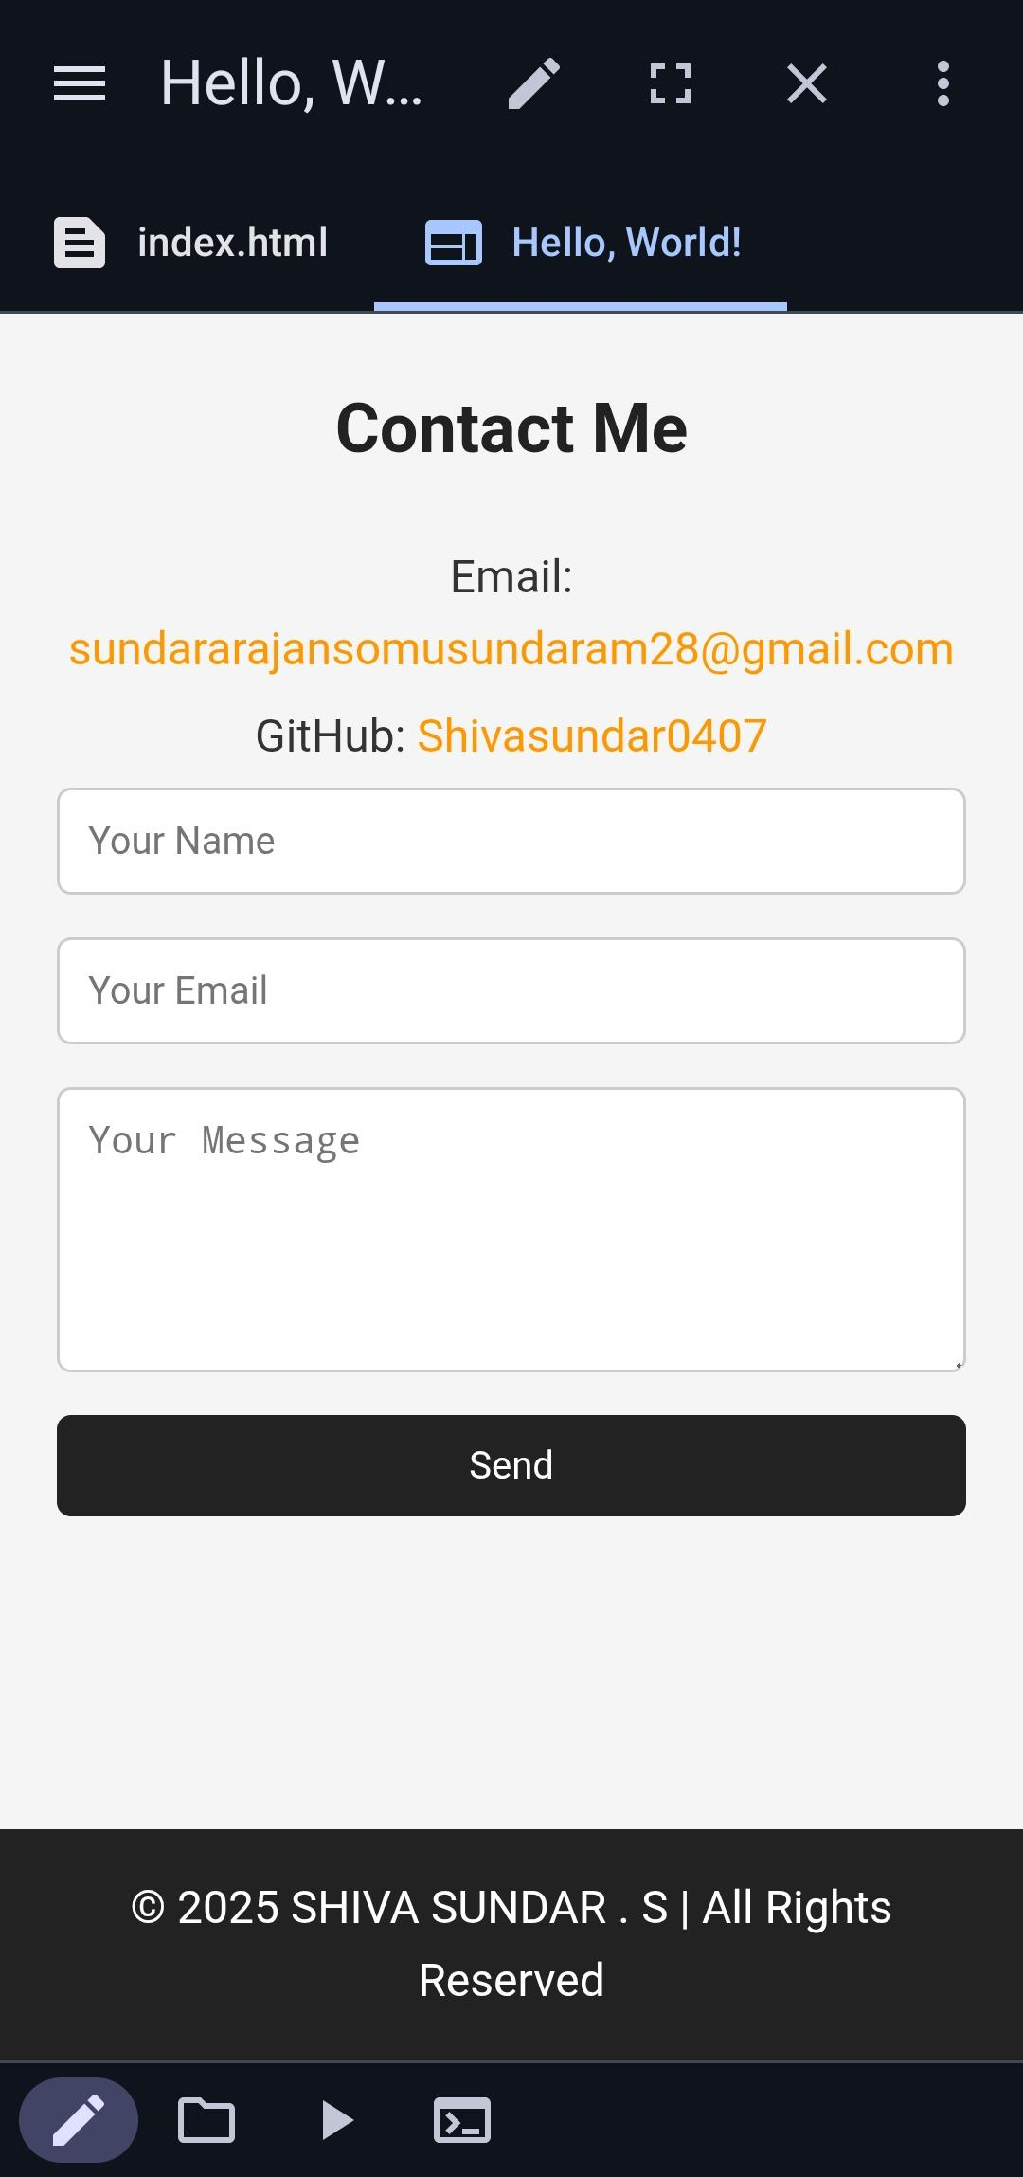
RESULTS AND SCREENSHOTS
Successfully created a functional and responsive digital portfolio.
Showcases personal information, projects, and skills in a professional format.
Screenshots demonstrate layout, responsiveness, and interactive features.
3/21/2024 Annual Review
‹#›

Slide 11
CONCLUSION
The digital portfolio effectively highlights academic, technical, and professional achievements. It serves as a modern alternative to resumes and enhances online presence, making it easier to connect with recruiters, clients, and collaborators.
‹#›

